Slide 1
An Overview of the Promotion & Tenure Process
University of Kentucky New Faculty Orientation
August 20, 2015
Katie Cardarelli, PhD
Associate Dean for Academic and Student Affairs
College of Public Health

Slide 2
Objectives and Intention
To summarize the Promotion and Tenure Process
To provide a timeline for this process
To provide guidance on achieving promotion and tenure goals
To distinguish P&T for all title series
To identify resources for faculty

Slide 3
Guiding Principles
Promotion & Tenure procedures
Administrative Regulations (AR) 2:1-1 procedures
Revisions by administrators (Provost Memos)
Reports available
Notes:
Reports on http://www.uky.edu/Provost/APFA/Promotion_Tenure/PT%20cases%202011-12%20across%20all%20levels%20by%20colleges.pdf

Slide 4
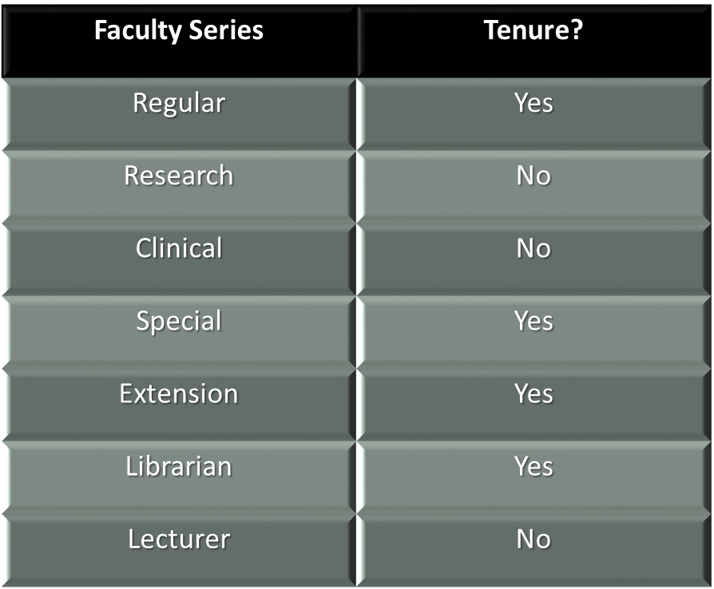
UK Faculty Series

Slide 5
Title Series Comparison— Regular Title (Tenurable)
Teaching, Advising, Instruction
Creative Activity/Research
Professional, University, Public Service
Notes:
AR 2:2-1 regular title series: (1) teaching, advising and other instructional activities; (2) research or other creative activity; (3) professional, University, and public service. Evaluation of a faculty employee’s performance in each area of activity should be commensurate with his or her approved distribution of effort agreement. Excellence in teaching, advising and other instructional activities, research or other creative activity, and in professional, University and public service is expected.

Slide 6
Title Series Comparison— Research Title (Nontenurable-Promotable)
Creative Activity
Limited Duration
Designated Funds
Notes:
Research Title Series (AR 2.5) http://www.uky.edu/regs/files/ar/ar2-5.pdf
(1) involve research or other creative activity, (2) are of limited and specified duration, and (3) the institution operates under contracts, grants, or other designated funds. A faculty employee on appointment in the Research Title Series shall not have any regularly-scheduled teaching or service assignments.

Slide 7
Title Series Comparison— Clinical Title (Nontenurable-Promotable)
Clinical Title
Health Care Programs
Clinical Practice
Instruction/Experiential
Service to Clients/Patients
Patient Care Services
Professional Expertise
Student/Clinical Experience
Notes:
Clinical Title Series (AR 2.6) http://www.uky.edu/regs/files/ar/ar2-6.pdf
clinical practice, service to clients or patients, and experiential training of students of the profession. For those faculty employees appointed to Clinical Title Series positions in health care programs,
the primary responsibilities are to provide patient care services, to expose students to their professional expertise, and to direct students’ educational experience in the clinical settings where the faculty employee practices.

Slide 8
Tenure Progression – Six Probationary Years
Year 1—Setting the Stage
Year 2—Review & Mentoring
Year 3—Progress, National, Funding
Year 4—Review & Growth
Year 5—Meet Metrics or Change Careers
Notes:
Annual faculty reviews are different from the Year 2 and 4 reviews.

Slide 9
Year 1
Offer letter
Clear Workload
Review Evidence Statements
Know where these are located, provide to faculty with offer letter
If not developed for all title series in your college, refer to promotion/tenure criteria in the job description or university administrative regulations
Notes:
Evidence statements are for regular title series faculty (required by university March 1, 2010 for all units and is part of the unit rules document).

Slide 10
Performance Reviews: Year 2 & 4
Faculty Workload
Distribution of Effort
Chair and Tenured Department Faculty Review
Based on Faculty Workload on Position Description
Notes:
Tenured faculty review progress at year two and four. A written report is provided with recommendations: Listen and follow recommendations; an official copy is housed in the Dean’s Office
Differences between Faculty Workload and DOE
DOE—Dynamic
Faculty Workload—fixed upon hiring.
Per AR 3.8 (appendix) Workload may be defined as all faculty activities related to essential professional activities and responsibilities: teaching, research and creative activity, interacting with students, clinical care, institutional and professional service, service to the community, and professional development. The essential character of workload is established for all the diverse types of faculty appointments in the guidelines for reappointment, promotion, and tenure within the University and in the distribution of effort agreement that directs each faculty employee's working schedule. Workload management requires the realistic assignment of a faculty employee's time and University resources. Workload also includes external service activities performed by faculty employees on behalf of the general public, and internal service, or work on behalf of colleagues, students, and University units, and professional activities. While teaching, research, and service may be regarded as separate activities, in practice, these three workload components are rarely distinct. Administrative flexibility is required to assign and assess research, service, and teaching. Therefore, workload assignments should be determined by educational unit administrators who understand the abilities and interests of their individual faculty employees.

Slide 11
What is the WL and DOE difference?
Faculty Workload
Distribution of Effort
Category | Percentage
Instruction/Advising | 40%
Research | 40%
Professional Development/Service | 20%
Category | Percentage
Instruction/Advising | 80%
Research | 10%
Professional Development/Service | 10%
Notes:
Evaluated on how DOE most closely matches workload
Recall that for Health Behavior Research Evidence statement that faculty should:
Have a well-defined research agenda – one that is tightly centered on a focal point
strive to publish at least two articles in peer-reviewed journals each year
have been awarded (as PI) at least one externally funded grant

Slide 12
Performance Reviews: Years 2 & 4
Chair and Tenured Department Faculty Review
Mandatory at 2 and 4 years, but may be done after 1 and 3
Digital Measures – Productivity Data
Information entered from CV
Updated annually
Reports generated
Faculty Administrator should prompt Chair when reviews are necessary (Resource: Faculty Affairs College Contacts)
Notes:
Set meeting time; faculty member being reviewed presents evidence of progress as outlined in faculty workload on the position description.
Adjust DOE if necessary due to projects/funding.

Slide 13
Year 3
Review original workload, offer letter, evidence statements
Key suggestions:
Pre-appointment research activities
Regular meetings with Mentor
National activities
Grant funding
Demonstrate improvements in teaching
Possible consideration of workload revision or change of title series

Slide 14
Year 5
This is THE year for faculty to compile his/her Dossier
Sustain activities
Plan for letters of support:
Do you have national colleagues who can provide an evaluative letter?
Department assistant and Faculty Affairs help manage the dossier compilation process
Notes:
Meet the metrics or begin thinking about alternative career options…
Moving towards preparation for the Dossier process which is in year 6—Key point is that you do NOT need to get letters yet, just identify key individuals to include support for promotion.

Slide 15
Dossier
Joint Effort:
Faculty Member
Academic and Faculty Affairs Office
Department Administrative Assistant
Key Elements
Position Description/Workload
External Letters
Internal Letters
Evidence (Including Periodic Reviews)
Notes:
So the dossier is your documentation for promotion and tenure review. Something to point out is that all faculty who teach must complete a teaching portfolio.
Gather appropriate information; Include statements for teaching, service, and research/scholarly activity; Teaching portfolio includes summary of teaching evaluations; Research = grant funding, external support, published articles, accepted articles, letters documenting acceptance, book chapters,; Service, local, state, UKY, regional or national/international organizations.
Updated CV
Statements
Evidence or work artifacts

Slide 16
APT Committee
Dossier Reviewed and Discussed
Dean
Dossier and APT Recommendation Reviewed
Academic Area Committee
Dossier and all prior recommendations reviewed
Board of Trustees
Recommendation based on “worthiness”
Recommendation Letter Added
Provost
Recommendation made
Dossier reviewed and all prior recommendations reviewed
Approval
Final Approval
November
December-January
January-March
May
March-April
Notes:
Emphasis on BALANCE and framed by Workload
Role of Academic and Faculty Affairs
Processes
Q&A resource
UKY Evaluations Matrix

Slide 17
Area P&T Role and Functions
Reviews “worthiness” of candidate based on dossier materials
When reviewing dossiers:
APT Committee Chair leads discussion in committee
Strengths & Weaknesses
Vote taken after discussion
Vote and Key Discussion Points relayed to Dean
Recommendation made to Dean
Comprised of faculty members with Associate Professor or higher rank
APT Chair appointed by Dean
Notes:
The APT is the only standing committee that is not appointed by faculty council but is by Dean.
Conflicts of interest (members in your department) are recused from review of promotion materials.
APT is a standing committee serving in an advisory role to the Dean
Roles include:
Establishes policy for how it functions
Establishes guidelines for preparing job descriptions
Establishes guidelines for individuals writing letters of support, including the definition of scholarship
Reviews appointment dossiers for individuals appointed at the rank of Associate Professor or above
Reviews dossiers for promotion and/or tenure
Members may Advise untenured faculty on a successful journey to promotion and tenure
Members may serve as a surrogate faculty member when departments do not have many who are tenured.
Dean reviews decision and makes own assessment following APT recommendation.

Slide 18
Successful Promotion of Faculty
Focus on organization and be proactive
Encourage regular CV updates
Engage in regular reviews
Meet for frequent mentoring
Ask process questions specific to your college
Finding the path to success…
Notes:
Evaluate your faculty’s progress.

Slide 19
The next phase of your journey begins!

