Slide 1
New Faculty Orientation
An Introduction to the UK INTERNATIONAL CENTER

Slide 2
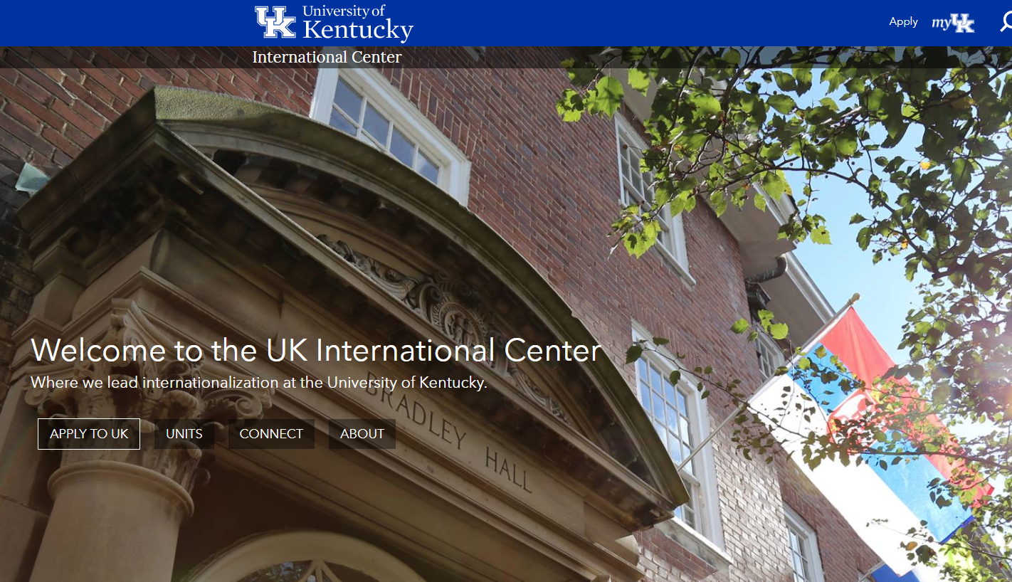
Internationalization at UK
Sue Roberts, Associate Provost for Internationalization
UK International Center
International Advisory Council
UK Strategic Plan
www.uky.edu/international

Slide 4
International Student & Scholar Services (ISSS)
Immigration Advising & Compliance
Student Success & Retention
Intercultural & Social Programming
Support for Hosting & Hiring
Notes:
ISSS offers services for both international students as well as international faculty.
Types of Services:
Immigration Advising: Immigration advising of students and international faculty in maintaining personal immigration status and reporting official data to Homeland Security to ensure UK compliance
Academic Retention: Secondary advisor offering programs and support unique to international student academic challenges that leads to increased retention
InterCultural and Social Programming: Programming designed to help with acculturation process to both UK and the USA, to facilitate international and domestic student interaction, and to enhance intercultural communication skills (e.g. bi-annual Cross-Cultural Workshop).
Hosting or Hiring International Faculty and Scholars: We facilitate the documentation necessary for Colleges and departments to host (or hire) international research scholars, staff and international faculty as they engage in employment, teaching, and research at UK

Slide 5
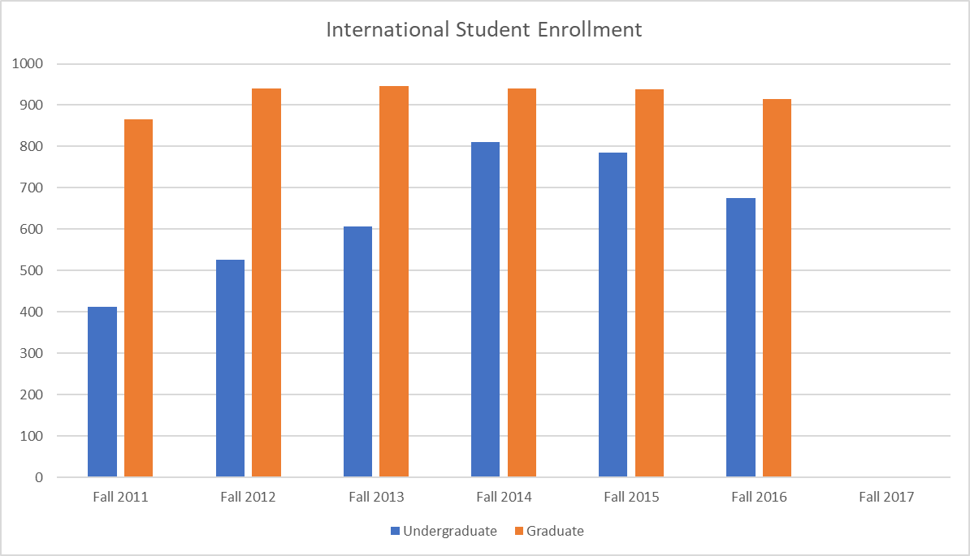
International Students
Top-sending Countries
China
India
South Korea
Colleges with the Most International Students
Engineering
B&E
A&S
CAFE
Notes:
Who are our international students?
Primarily funded by family or personal funds Diversity of backgrounds and experiences:
High schools in USA or International Schools w/o English curriculum
Transfers from other U.S. universities
Transfers from international universities (e.g. 2+2 programs)
Previously enrolled in ESL programs in U.S. or abroad
Part of a special cohort or non-degree exchange students
Some are well traveled with others have never been outside of home
country
Fulbright grantees
Grad numbers: 58% China, 20% India; 10% S Korea
Undergrad: 41% China; 18% Oman; 13% Brazil, 7% S Korea
Year/international
2014
1884
2013
1724
2012
1,621
2011
1,430
2010
1,409
2009
1,273
2008
1,263

Slide 6
Education Abroad & Exchanges
STUDY ABROAD
RESEARCH ABROAD
INTERN ABROAD
SERVICE ABROAD
TEACH ABROAD
Notes:
Education Abroad facilitates high-quality academic programming for a breadth of international experiences – study, research, internships, service and teaching.
UK Education Abroad collaborates with academic units to develop major-specific advising resources to assist students with selecting programs that most closely align with each degree program.

Slide 7
1,121 UK students studied abroad for academic credit in 16/17
Increasing number of students choosing to study in non-traditional destinations
Growing interest in international research, service-learning and internships
Faculty-directed programs are increasingly popular
Maximizing accessibility for underrepresented groups: minority students, first-gen students, and other underrepresented populations
Notes:
If a question arises concerning the numbers. Clarify the TERM in which these number are reflected. For example: CPE Census Report for fall 2013 for KY was 1724 but the IIE Report reflects numbers for fall 2012 (not fall 2013). Also, the IIE report includes ESL students and our state report only reports degree-seeking students
UK ranks 106 out of 1410 institutions reporting data. We are no longer last when using the NEW Benchmarks Identified by the University Review Committee (on the Institutional Research website)
Miko’s comments:
These numbers reflect the overall participation in FOR-CREDIT education abroad programs, both at the undergraduate and graduate level. This does not include the several hundred non-credit education abroad participants that also travel abroad through UK.
Enrollment in education abroad has grown considerably in recent years and has far outpaced national averages. Participation in credit-bearing programing has grown from just under 600 students in 2009-10 to over 1200 students in 2015-16.
Faculty-directed programs have experienced the largest growth in enrollment. UK offered 10 faculty-directed programs in 2009-10. The number of programs has since increased to 44 faculty-directed programs in 2013-14, 56 in 2014-15 and 2015-16.
Similarly, the number of UK faculty members teaching with our consortia (KIIS & CCSA) grows each year and contributed to 12% of the total enrollment.
Our focus on making education abroad accessible to students who are traditionally underrepresented in education abroad enrollment continues to be a priority. For example, minority student representation in education abroad enrollment continues to mirror enrollment demographics of the university student body and exceeds national averages.
In the fall and summer of this year, UK Education Abroad managed the awarding of over $270,000 in scholarship monies, where more than two-thirds of our applicants received an award.
Most popular country destinations are Spain and the United Kingdom.

Slide 8
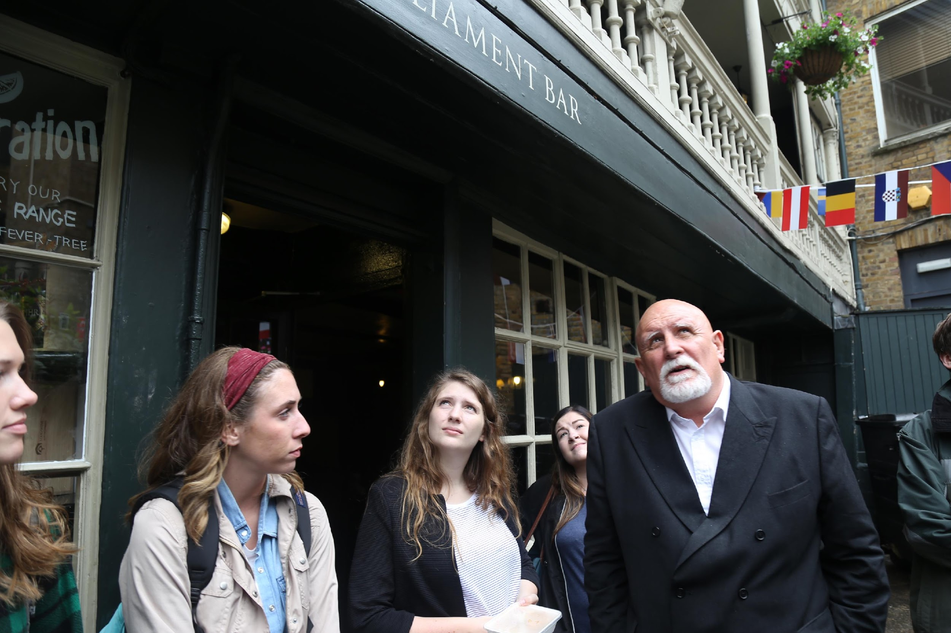
Education Abroad & Exchanges
Education Abroad Program Development Grant (< $2,000)
Deadlines are September 1 and February 1
Education Abroad Site Visit Grant ($200, rolling deadline)
Program Site Visits
Faculty Development Seminars (as available)
Notes:
Develop your own education abroad program in conjunction with EA and your department
Information at the Resource Fair for how to get started creating your own program
Teach abroad on a customized or consortium program
If you are not comfortable developing your own program, but want to teach, we have ways for you to gain experience teaching on programs
Education Abroad Program Development Grant (< $2,000)
EA offers financial support for faculty wanting to develop their own program
Program development grants allow faculty to gain first-hand experience setting up their program logistics in advance of taking students
Deadlines are September 1 and February 1
Education abroad site visit grants ($200, rolling deadline)
If you are traveling internationally for research or otherwise, EA would like you to visit our partners to review and vet our programs in your area
Program site visits & Faculty development seminars (as available)

Slide 9
International Partnerships and Research
Student
Recruiting
Development &
Fundraising
Bilateral
Agreements
Grants &
New Business

Slide 10
International Health, Safety and Security
UK employees took at least 1,199 international trips in 2016
Travel Registry
Please register all international travel before departure! (https://ihss.uky.edu)
This will guarantee coverage under UK’s insurance and ensure easy communication
Travel Medical Insurance & Evacuation Coverage
Comprehensive coverage while abroad
No cost to the employee (register to guarantee coverage)
Proactive Alerts
IHSS will contact you via the travel registry in the event of an emergency in your host country or at home, and with other important institutional information/support

Slide 11
Confucius Institute
UK Faculty Summer Teaching in China
2-4 weeks, paid airfare and accommodations
Teaching stipend ($1200-$1600)
Faculty Grant
For international and domestic travel for China-related conferences, research, course field trips and curriculum development
Distinguished Speaker Series
Faculty can propose to invite up to five Northern American speakers on campus to speak on China related topics
Quality Chinese Culture/Art Performance
Brought directly from China to enrich campus culture life and classroom activities
Chinese culture/art demonstrations in classes
China visa service
Orientation for China and China trips

Slide 12
Office of China Initiatives
Offers UK Faculty Teach in China program
2-4 weeks, paid international airfare & China accommodations
Teaching stipend ($1200-$3000)
Provides orientations for Teach in China program
Identifies and facilitates faculty joint-research opportunities in China
Partners with UK faculty to develop teaching/research opportunities in China for UK graduate students
Facilitates connections among Chinese visiting scholars, UK faculty and colleges
Collaborates with center for enhancement of learning and teaching (CELT) and UK colleges to offer professional development workshops for faculty to advance understanding of Chinese culture, and to enhance instructional effectiveness for Chinese students

Slide 13
Global
Health Initiatives
Shoulder to Shoulder Global
Shoulder to Shoulder Global

Slide 14
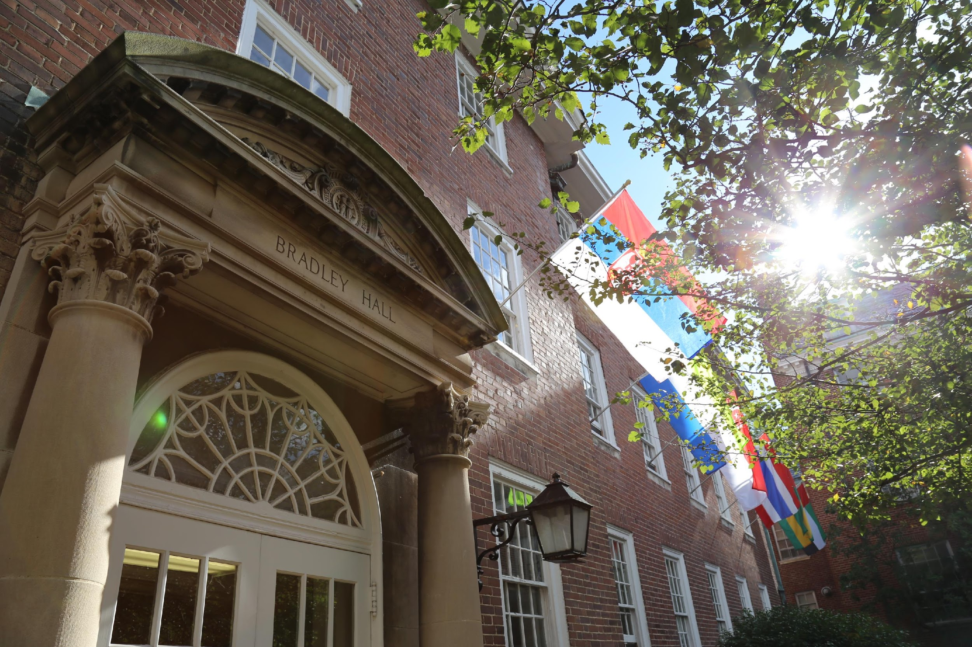
WHERE TO FIND US
Bradley Hall- plus new CI in Little Library

Slide 15
Thank you very much!

